Slide 1
Analysis of Customer Support results
2021-2023
Karolina Folek

Slide 2
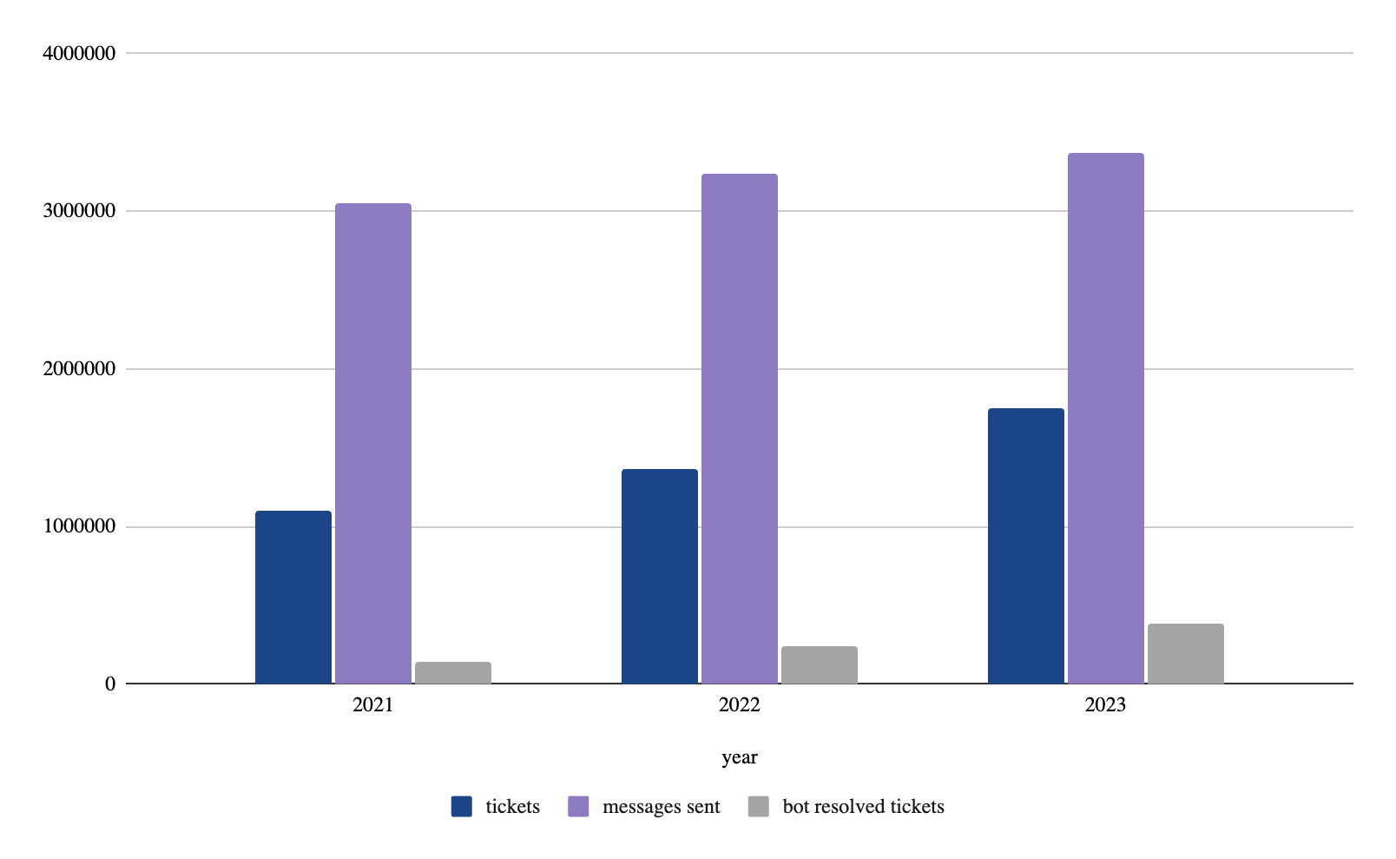
Tickets summary in 2021-2023
year | tickets | messages sent | bot resolved tickets
2021 | 1 095 794 | 3 044 203 | 136 575
2022 | 1 364 672 | 3 242 245 | 236 805
2023 | 1 745 702 | 3 374 635 | 384 809
The number of tickets increased in each year, as did the number of messages sent by CS.
There was also an increase in the number of tickets resolved by bots in the analysed years.

Slide 3
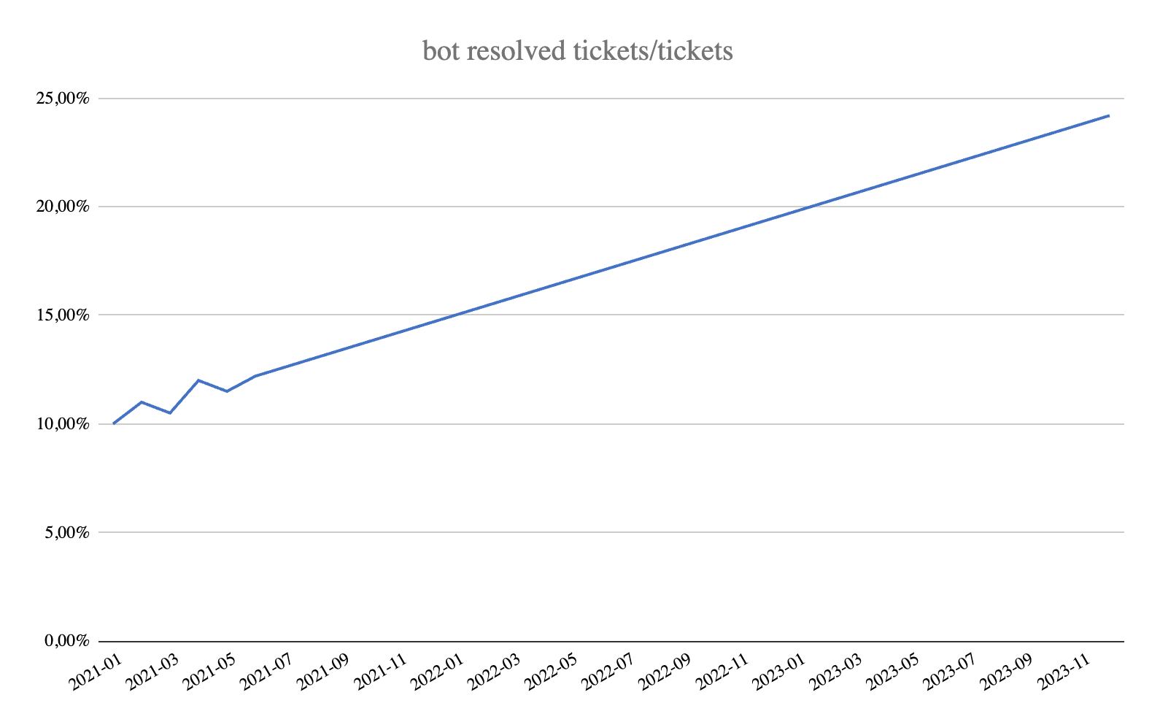
Bot resolved tickets
year | rate of tickets resolved by bots
2021 | 12,40%
2022 | 17,20%
2023 | 22,00%
The number of tickets solved by bots has increased significantly.
22% of tickets were solved by bots in 2023.

Slide 4
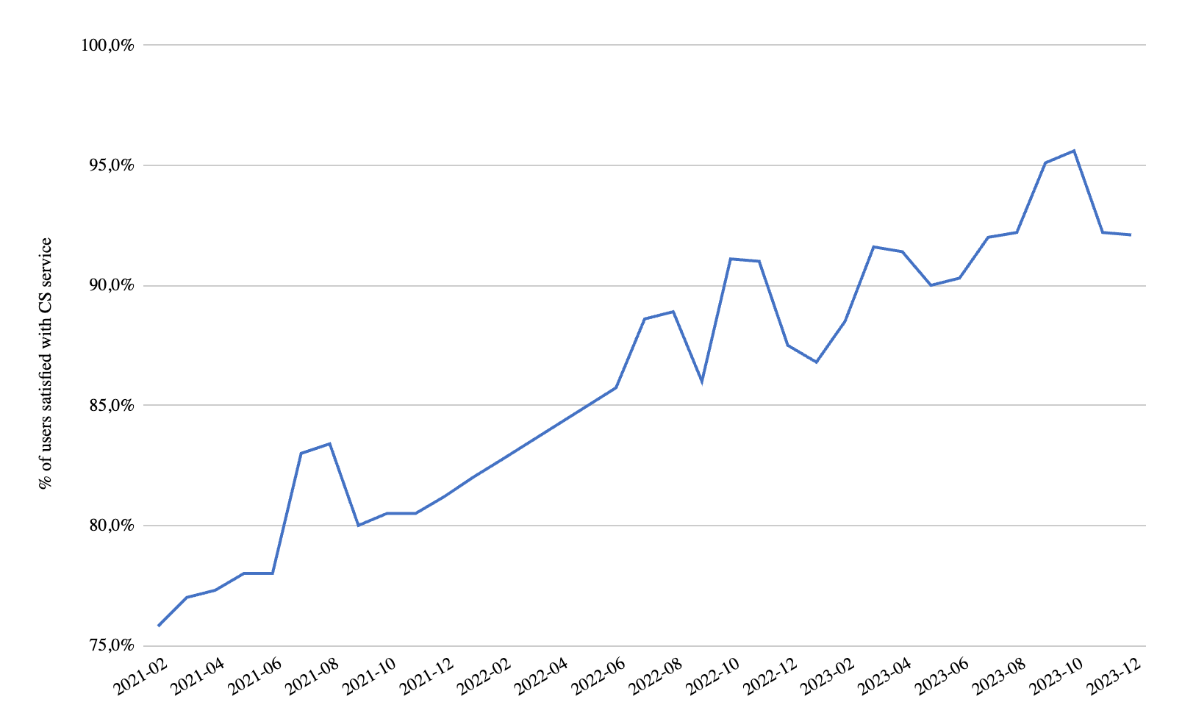
User satisfaction rate with CS
year | CSat
2021 | 79,2%
2022 | 86,4%
2023 | 91,5%
The user satisfaction rate increased in the years under review from 79.2% in 2021 to 91.5% in 2023.

Slide 5
Outsourcing, deliveries and promotions for deliveries
The Delivery Service via suppliers and promotions for shipments were gradually introduced.
The Delivery Service via suppliers was activated in 10.2022.
The promotions for deliveries were valid for the following periods:
10.2022 - 11.2022
03.2023 - 04.2023
09.2023 - 10.2023
The share of outsourcing staff fluctuated in the years analysed, with a share of 10% in 2021, falling to 0% in 2022 and increasing to 20% in 2023.

Slide 6
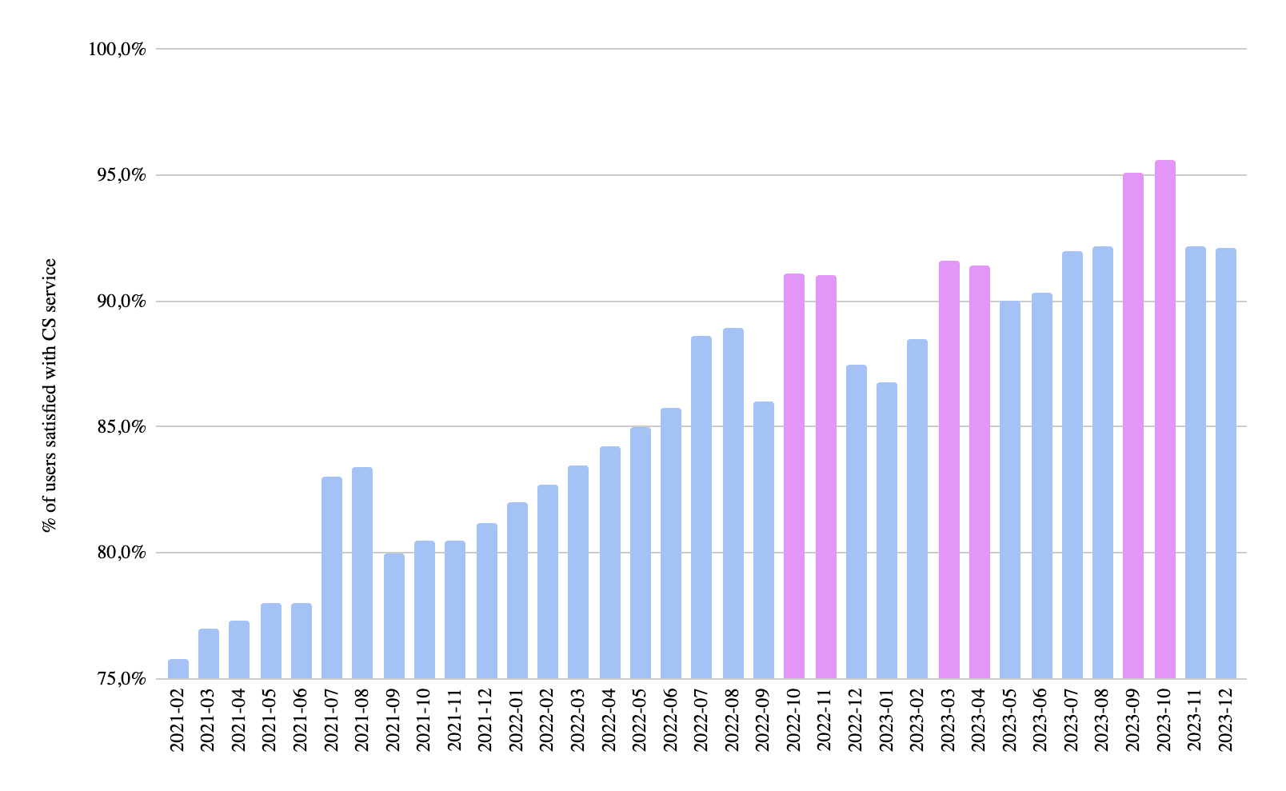
User satisfaction - deliveries
The activation of the delivery service via suppliers from 10.2022 has contributed to an increase in user satisfaction with the CS.
There is a noticeable increase in the rate of satisfied users in the months in which the shipment promotion occurred.
After the end of the promotion there is a noticeable decrease in the rate.

Slide 7
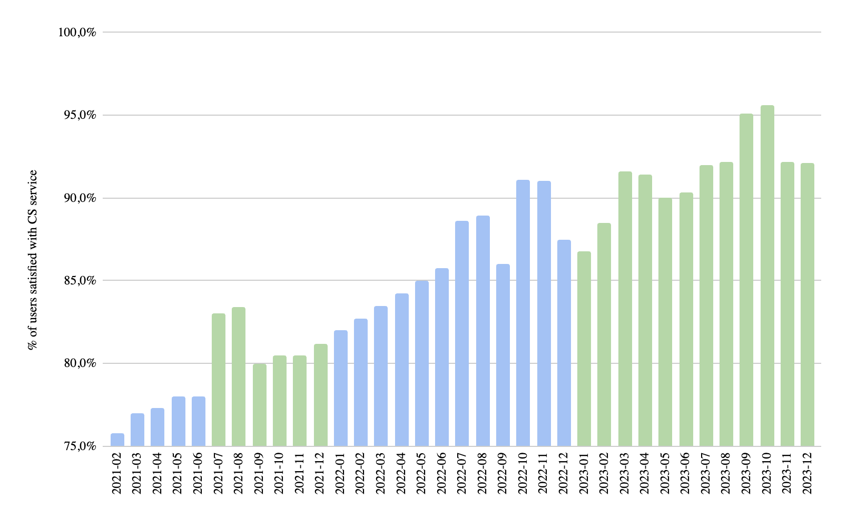
User satisfaction - outsourcing
The CSat ratio increased from 79.2% in 2021 to 91.5% in 2023, which may suggest that the reduction in outsourcing staff in 2022 had a positive impact on user satisfaction, while the increase in outsourcing staff in 2023 did not have a negative impact, which may be due to better management of outsourcing.

Slide 8
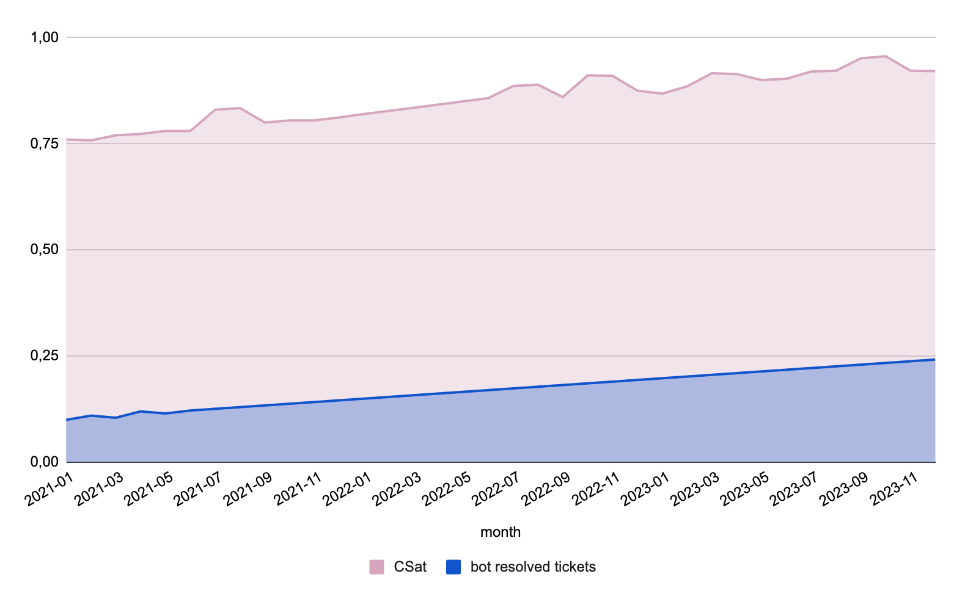
User satisfaction - bots
The increase in the number of requests resolved by bots between 2021 and 2023 correlates with an increase in the rate of satisfied users with Customer Support (CSat).

Slide 9
Optimisation of indicators
In order to maximise the user satisfaction rate with the CS (CSat), you should:
Optimise the number of requests resolved by bots. Bots can respond quickly to simple and repetitive requests, which contributes to reduced response times and problem resolution. With a continuous increase in the overall number of requests, it is very important to automate the handling.
Offer periodic promotions on shipments that affect user satisfaction due to more favourable service conditions. Introducing promotional offers also helps to increase traffic to the site, resulting in new users.

